Slide 1
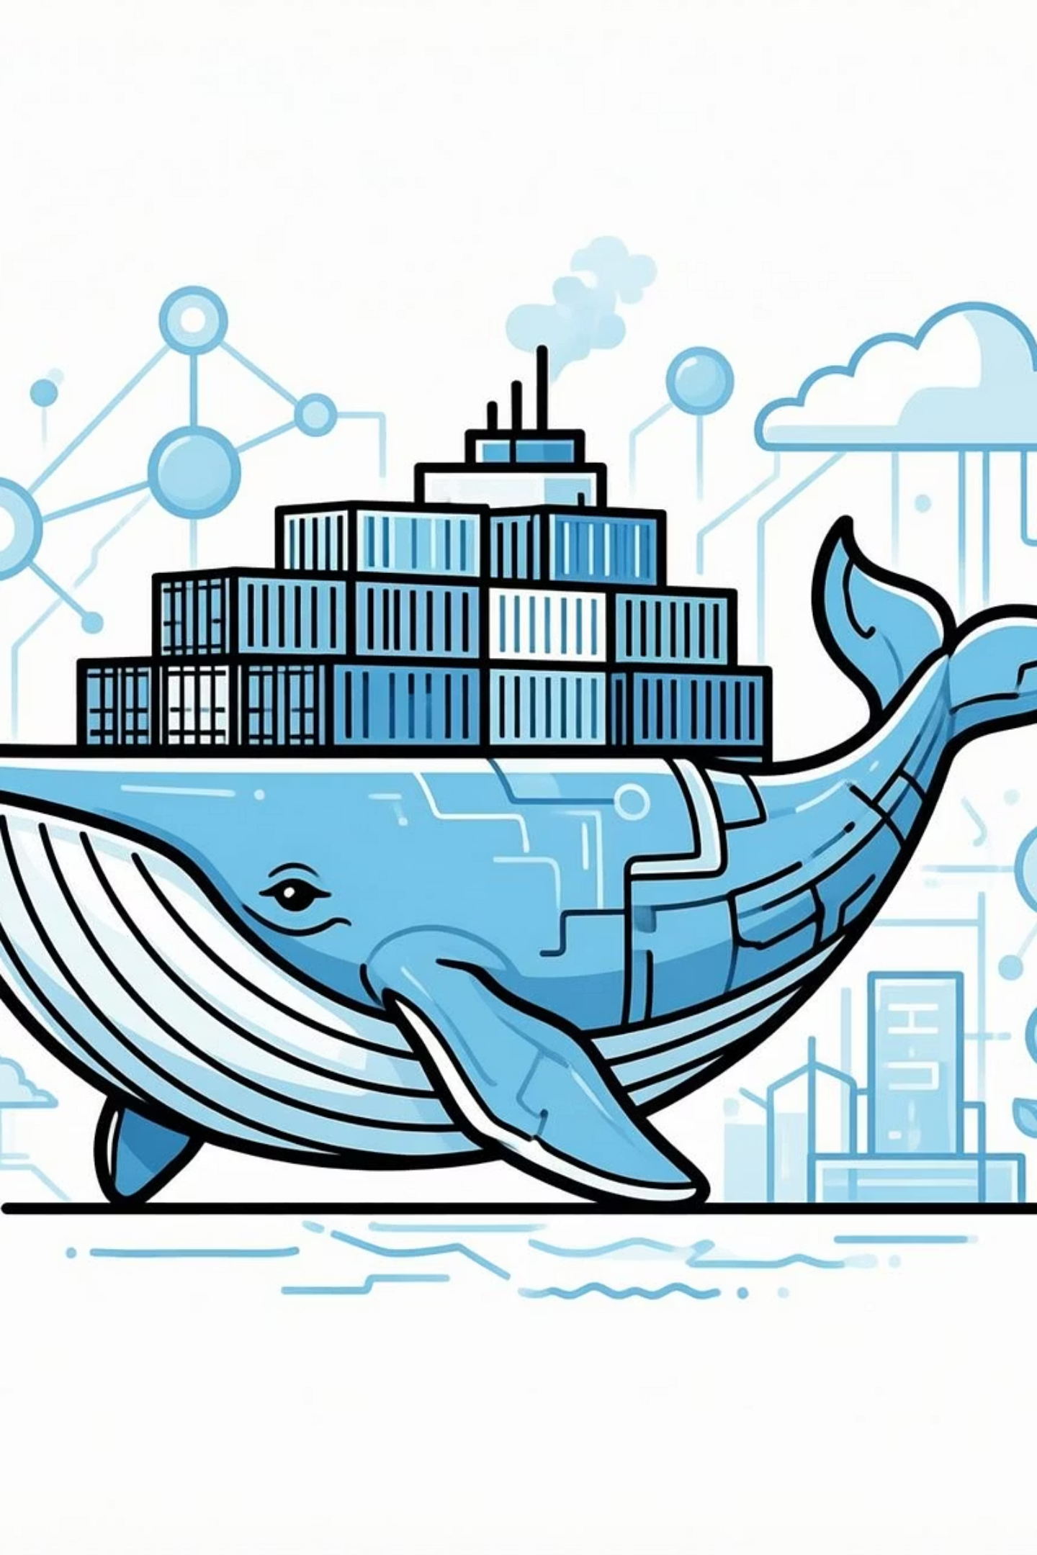
Welcome to the Docker Crash Course
By: Sohaila Ahmed

Slide 2

A Quick introduction about myself

Slide 3


GETTING STARTED
Now its time to hear from you: Your Journey, Our Goals
Your Background
Let me understand your experiences and what you'd like to achieve.

Slide 4

COURSE AGENDA
Unpacking the Docker Journey
Life before containers: Understanding the problems Docker solved.
Containers vs. Virtual Machines.
What are containers and how do container runtimes work?
Lab 1: Installing Docker.
Docker Images and creating Docker files.
Lab 2: Creating your first Docker image.
Exploring Docker Hub and image registries.
Managing images and containers: Essential commands
Lab 3: Practicing core Docker commands.
Deep dive into Docker image layers and caching.
Understanding Docker Volumes for data persistence.
Lab 4: Working with Docker Volumes.
Creating multi-containers with Docker Compose.
Pushing your images to Docker Hub.
Lab 5: Hands-on with Docker Compose
Docker Networking.
Summary and key takeaways.

Slide 5

THE PROBLEM
Life Before Containers: The Challenge
Inconsistency Across Environments
Inefficient Resource Utilization
Slow Deployment and Scaling

Slide 6
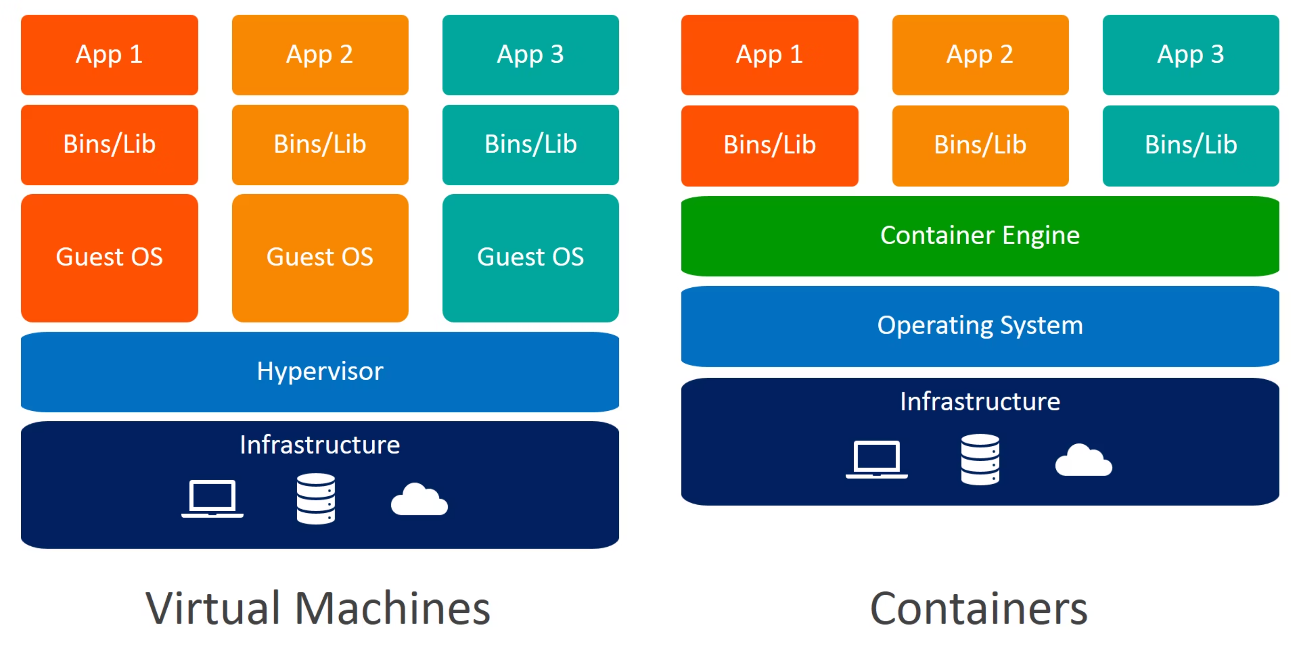
CORE CONCEPTS
Containers vs. Virtual Machines

Slide 7
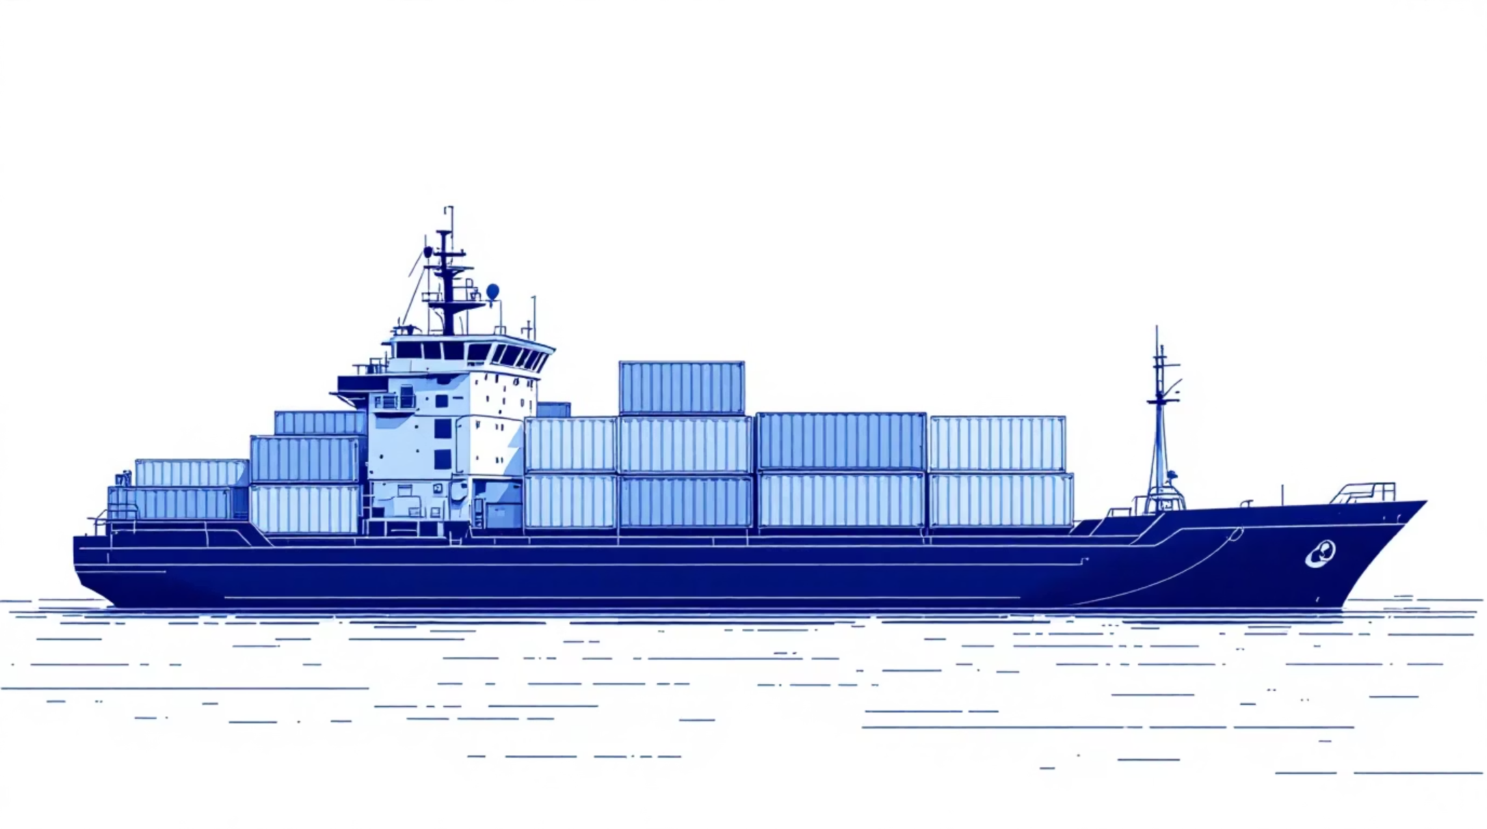
FOUNDATIONS
What are Containers & Runtimes?
Containers: lightweight, portable, self-sufficient units of software.
Container Runtimes: the engines that execute and manage containers like docker.

Slide 8
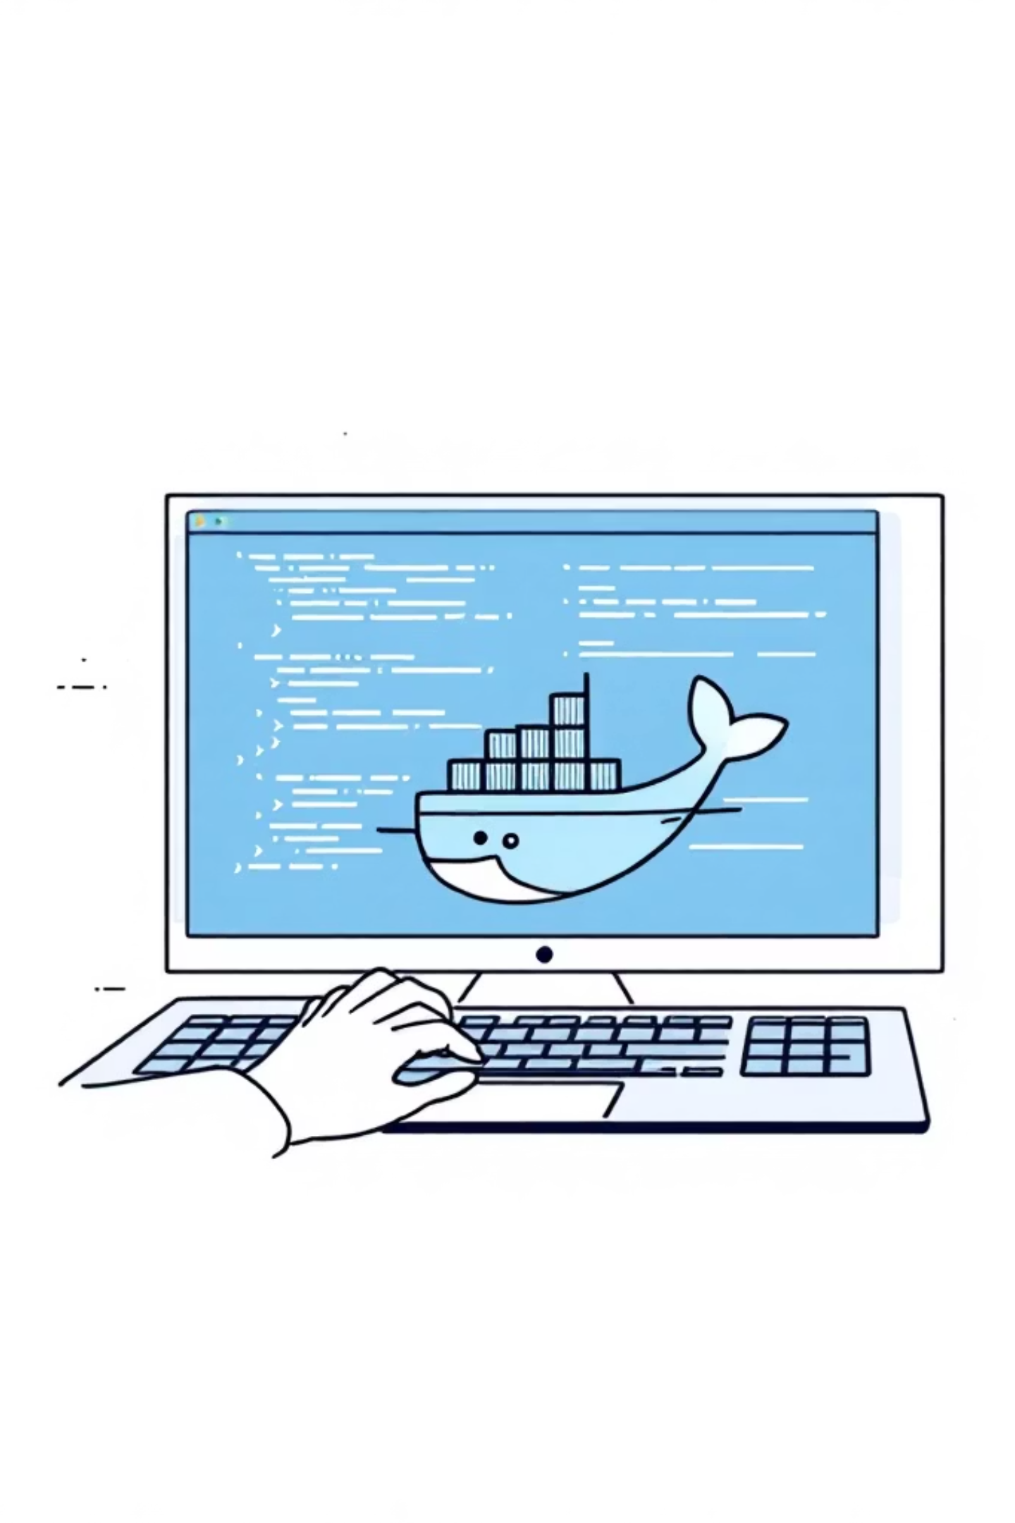
HANDS-ON LAB
Lab 1: Installing Docker
Let's get hands-on and set up our Docker environments.

Slide 9


BUILDING BLOCKS
Docker Images & Dockerfiles
Docker Images
Dockerfiles
Blueprints for our containers, immutable and shareable.
Instructions for building custom Docker images, layer by layer.
.

Slide 10
BUILDING BLOCKS
Dockerfile Example
A practical example of a Dockerfile for a Python application.
# 1. Base image FROM python:3.11-slim # 2. Set working directory WORKDIR /app # 3. Copy dependencies file (kept for structure / caching) COPY requirements.txt . # 4. Install dependencies (optional but structured) RUN pip install --no-cache-dir -r requirements.txt # 5. Copy application code COPY . . # 6. Expose port EXPOSE 8080 # 7. Simple run command (built-in web server) CMD ["python", "-m", "http.server", "8080"]
The FROM python:3.13 instruction specifies the base image, in this case, a specific version of Python, which provides the runtime environment for our application.
The WORKDIR /usr/local/app command sets the current working directory inside the container for all subsequent instructions, ensuring our application files are organized.
COPY requirements.txt ./ copies the dependency list, and RUN pip install --no-cache-dir -r requirements.txt installs all necessary Python packages efficiently.
COPY src ./src then adds the actual source code of the Python application into the container's working directory.
The EXPOSE 8080 instruction informs Docker that the container listens on port 8080 at runtime, although it doesn't actually publish the port.
Finally, CMD ["python", "-m", "http.server", "8080"] Starts a basic Python web server on port 8080, exposes that port from the container, and serves files from the /app directory.

Slide 11
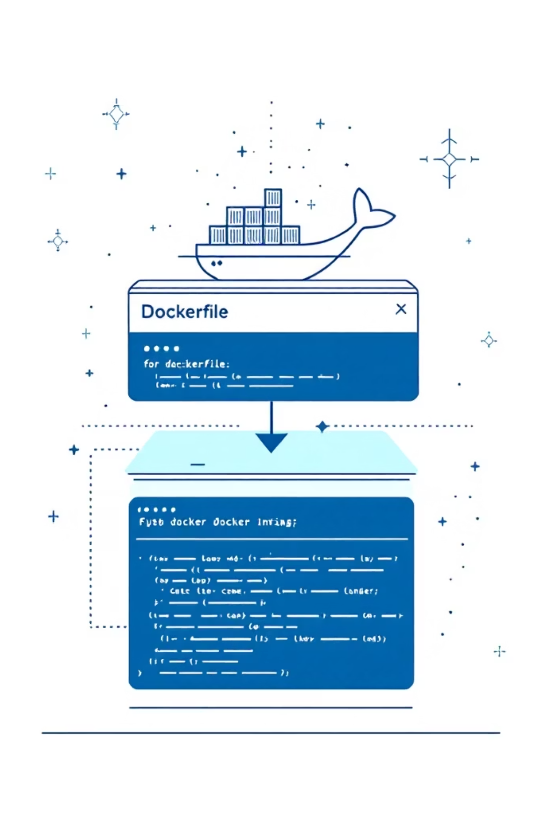
HANDS-ON LAB
Lab 2: Creating Your First Docker Image
Transforming your application into a container image

Slide 12
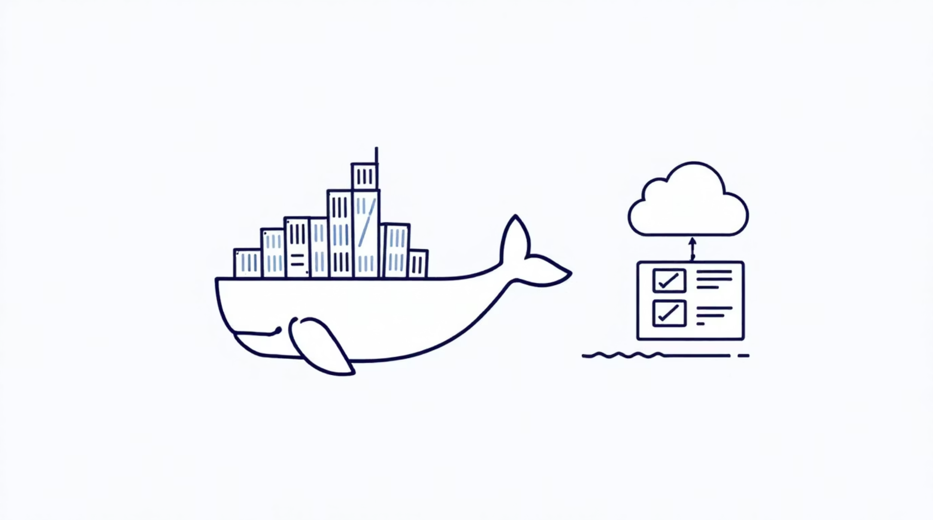
DISTRIBUTION
Docker Hub & Registries
The Container Marketplace
Central repositories for storing and sharing Docker images.
Public and private registries
Version control for images
Facilitates team collaboration

Slide 13



CONTAINERS AND IMAGES MANAGEMENT
Basic Docker Commands: How to manage containers
Image Operations
Container Operations
Monitoring and Troubleshooting

Slide 14
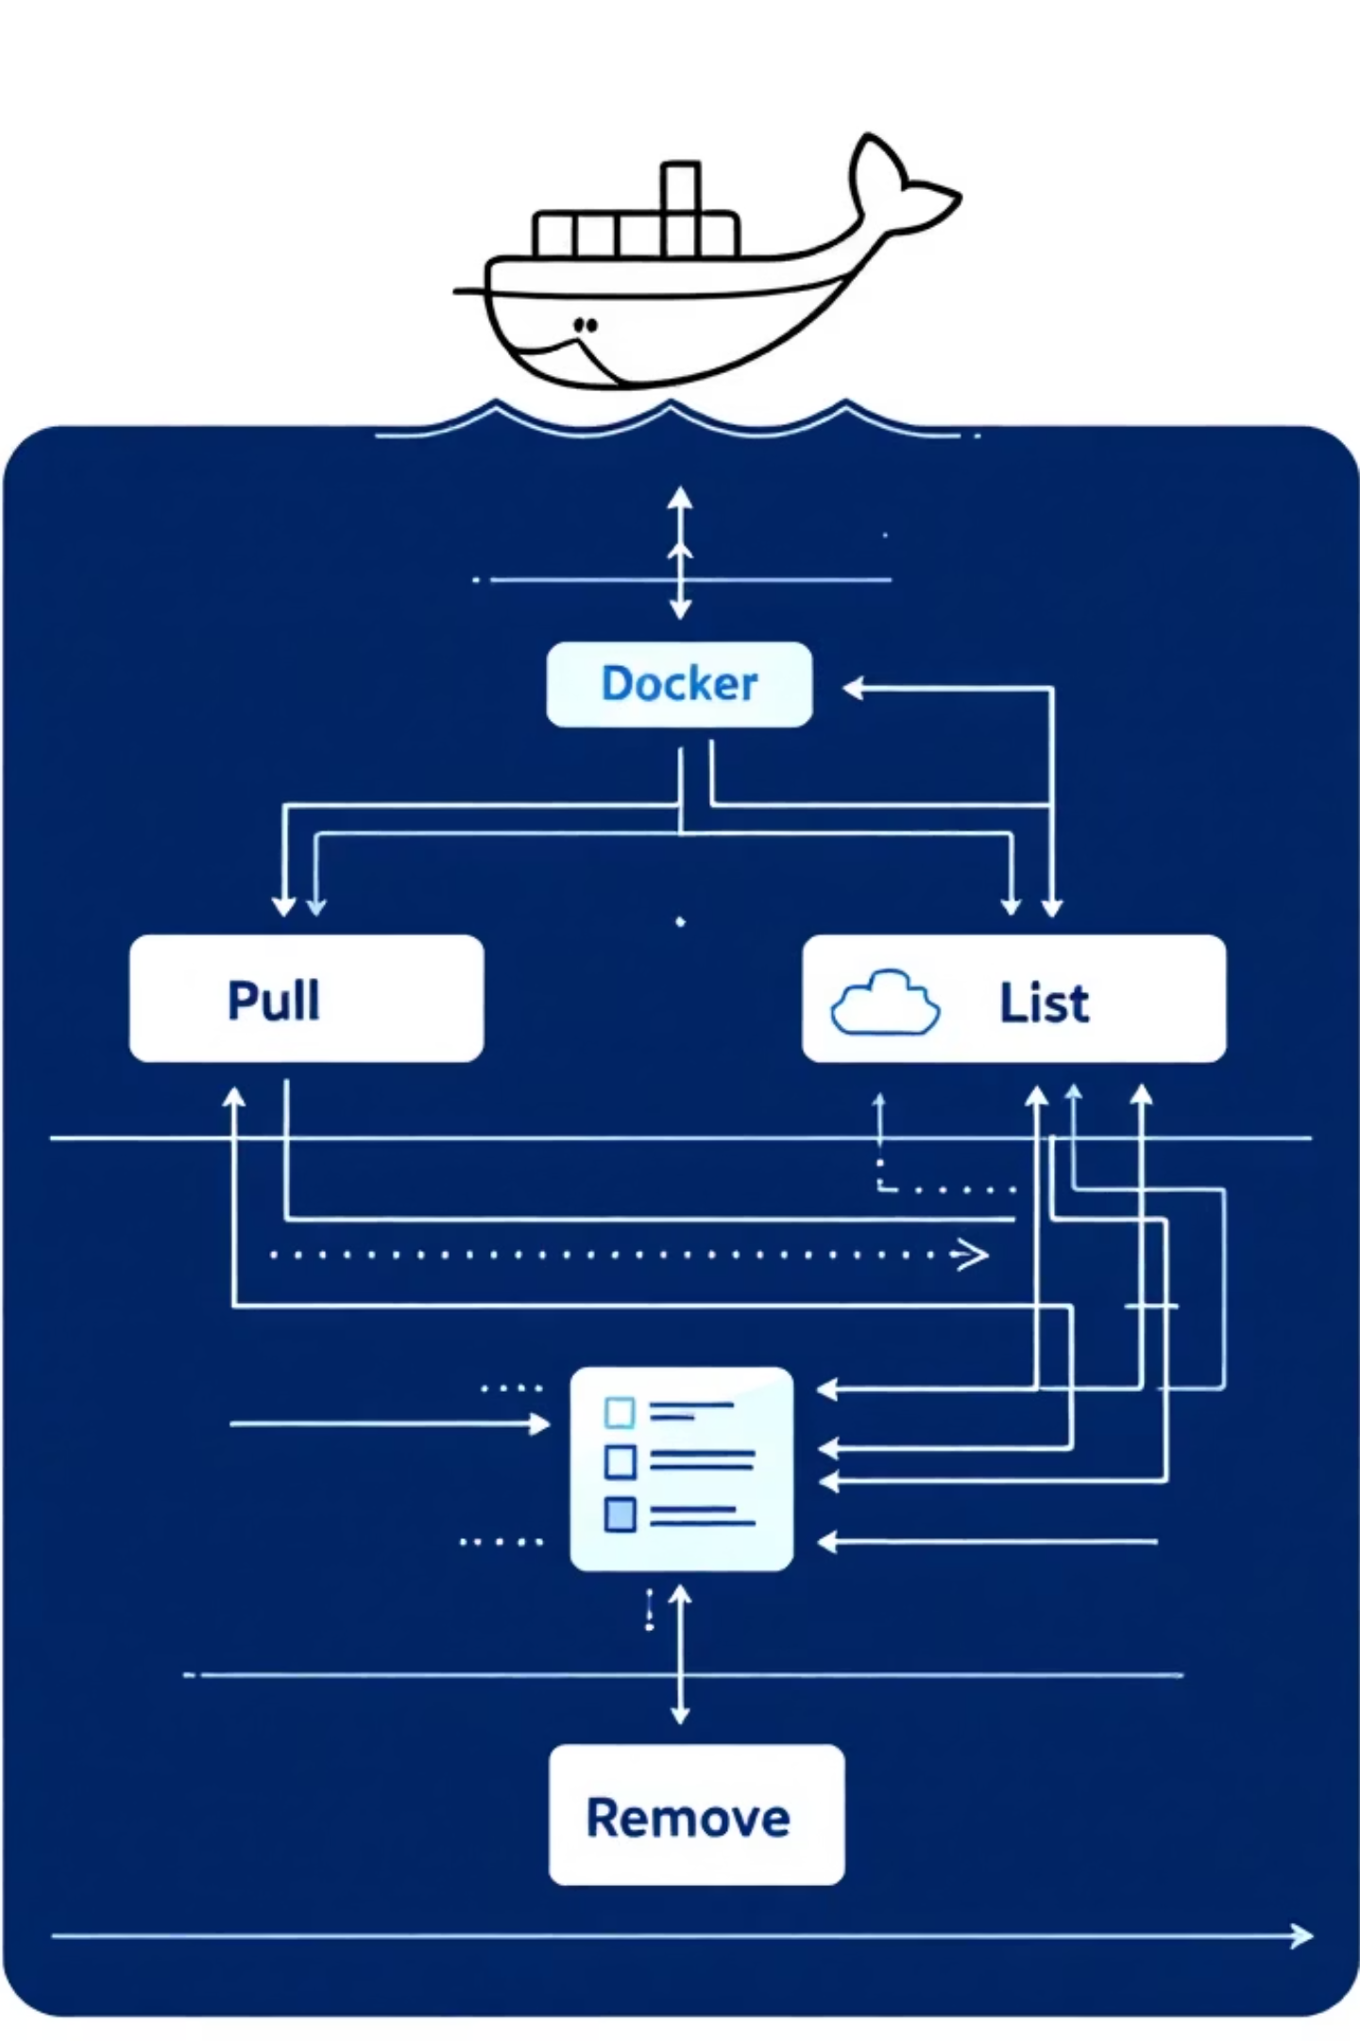




IMAGE MANAGEMENT
Image Operations
A comprehensive guide to managing Docker images with essential commands.
Pull Images
Build Images
List Images
docker pull <image>
docker build -t <name>:<tag> .
docker images
Remove Images
docker rmi <image>

Slide 15






CONTAINER MANAGEMENT
Container Operations
Mastering the fundamental commands for managing Docker containers effectively.
Run Containers
List Running Containers
List All Containers
Stop Containers
docker run -d -p <host>:<container> --name <name> <image>
docker ps -a
docker stop <container>
docker ps
Start Containers
Remove Containers
Execute Commands
docker start <container>
docker rm <container>
docker exec -it <container> bash
Run a command or open shell inside container

Slide 16





MONITORING & DEBUGGING
Monitoring & Troubleshooting
Essential commands for monitoring container health and diagnosing issues.
docker logs <container>
docker logs -f <container>
docker stats
View container logs
View resource usage
Follow logs in real time
docker inspect <container>
Detailed container information

Slide 17
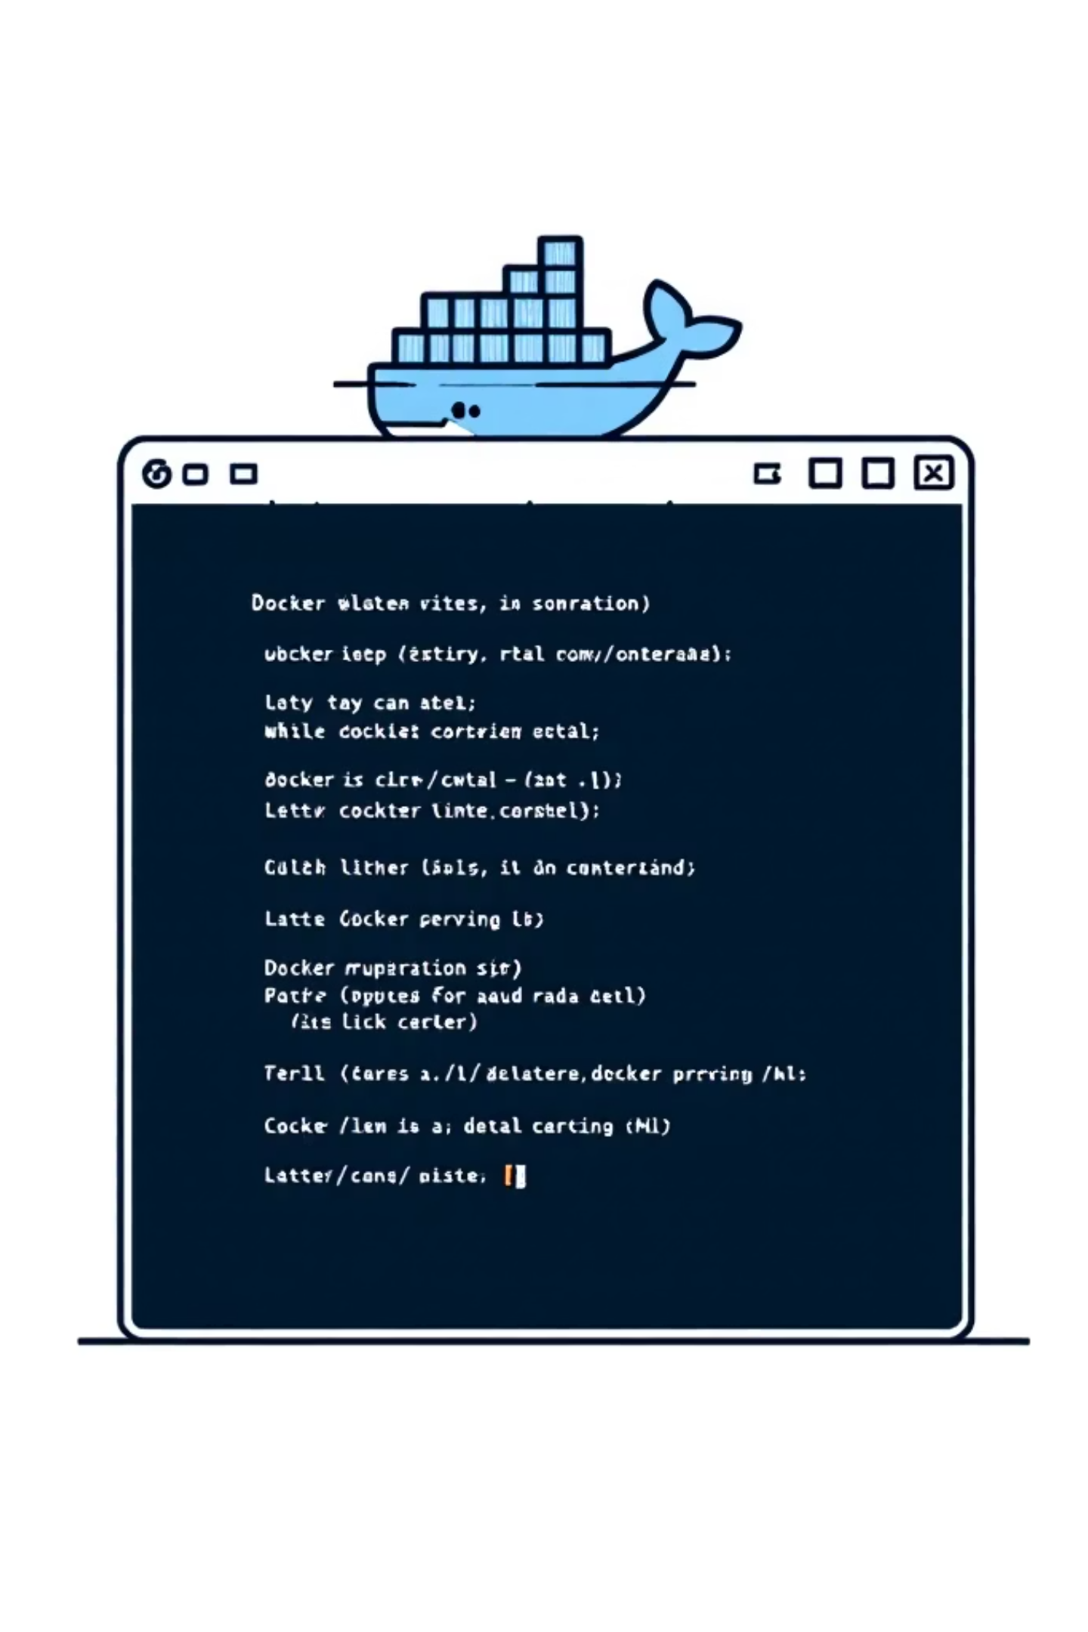
HANDS-ON LAB
Lab 3: Practicing Docker Commands
Hands-on practice with essential Docker commands.

Slide 18
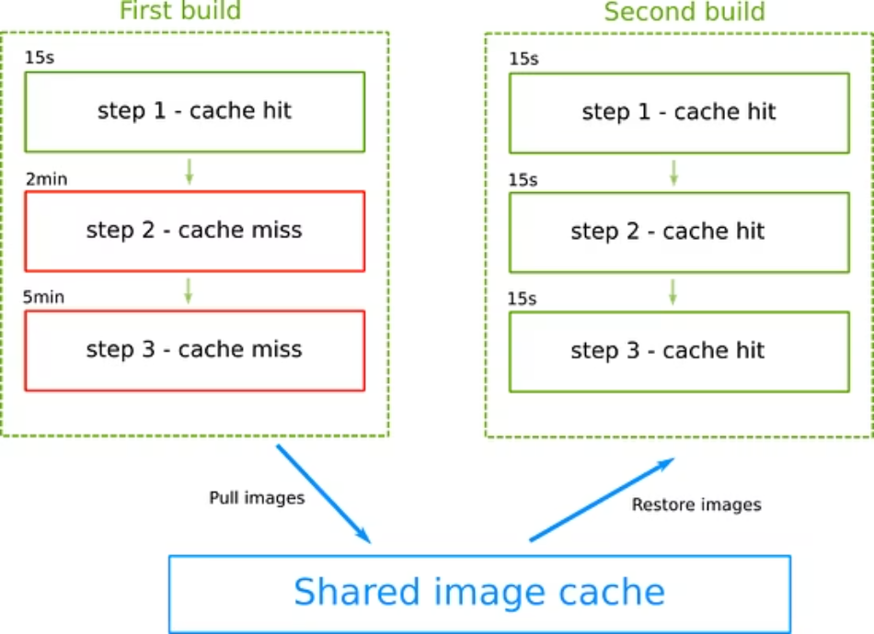
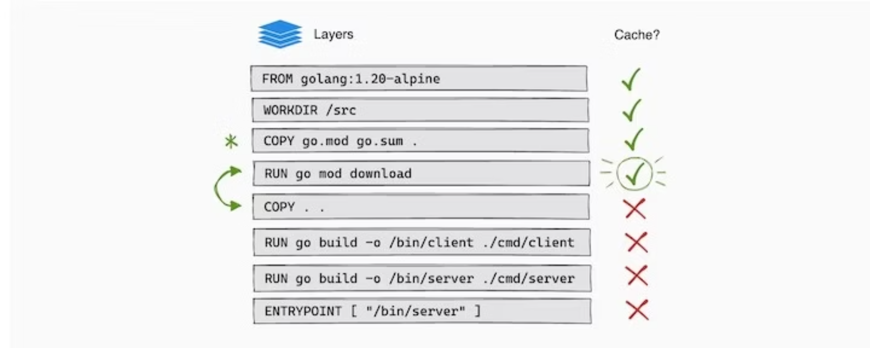
ADVANCED CONCEPTS
Docker image Layers caching
Docker image layer caching is a mechanism Docker uses to speed up builds by reusing previously built layers instead of rebuilding everything from scratch.

Slide 19
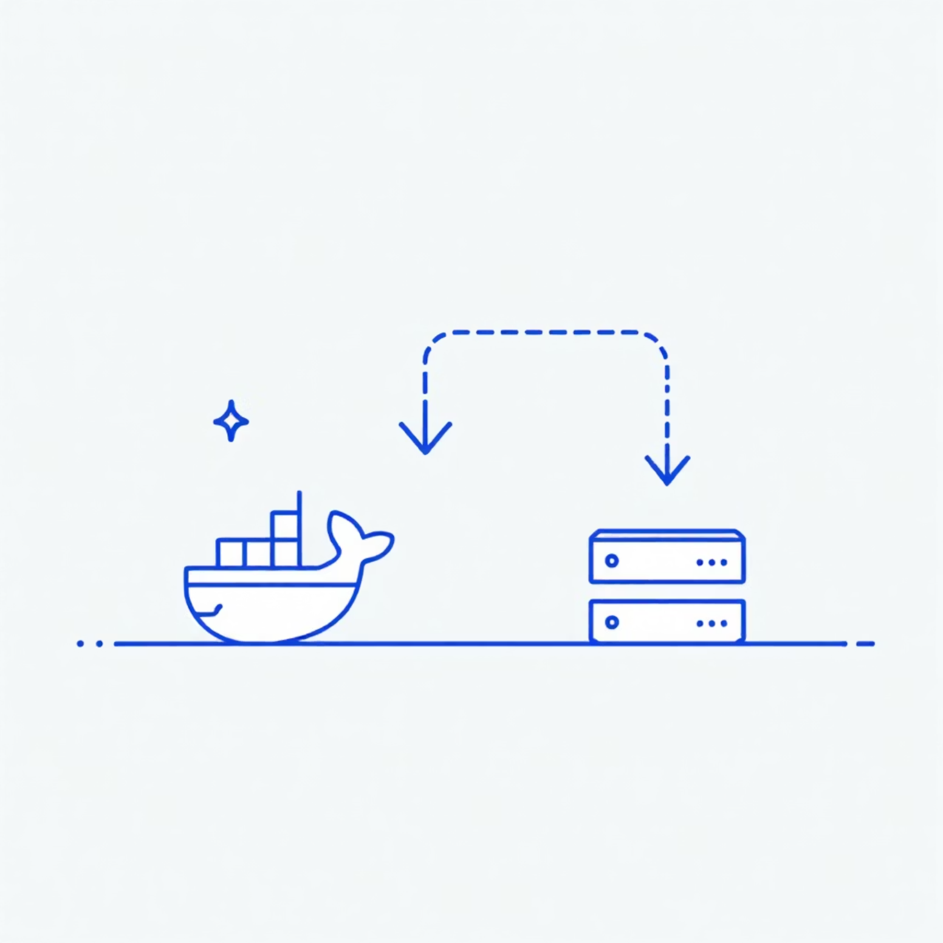
ADVANCED CONCEPTS
Docker Volumes: Ensuring Data Persistence
Docker Volumes are the preferred method for persisting and sharing data generated by Docker containers. They offer a reliable way to store application data independently of the container's lifecycle, meaning your data remains safe even if containers are stopped, removed, or recreated.
Reliability: Data survives container updates or removal.
Sharing: Easily share data between multiple containers.
Performance: Often provides better I/O performance.
Portability: Volumes can be backed up and migrated.
example: docker run -v mydata:/app/data myimage

Slide 20
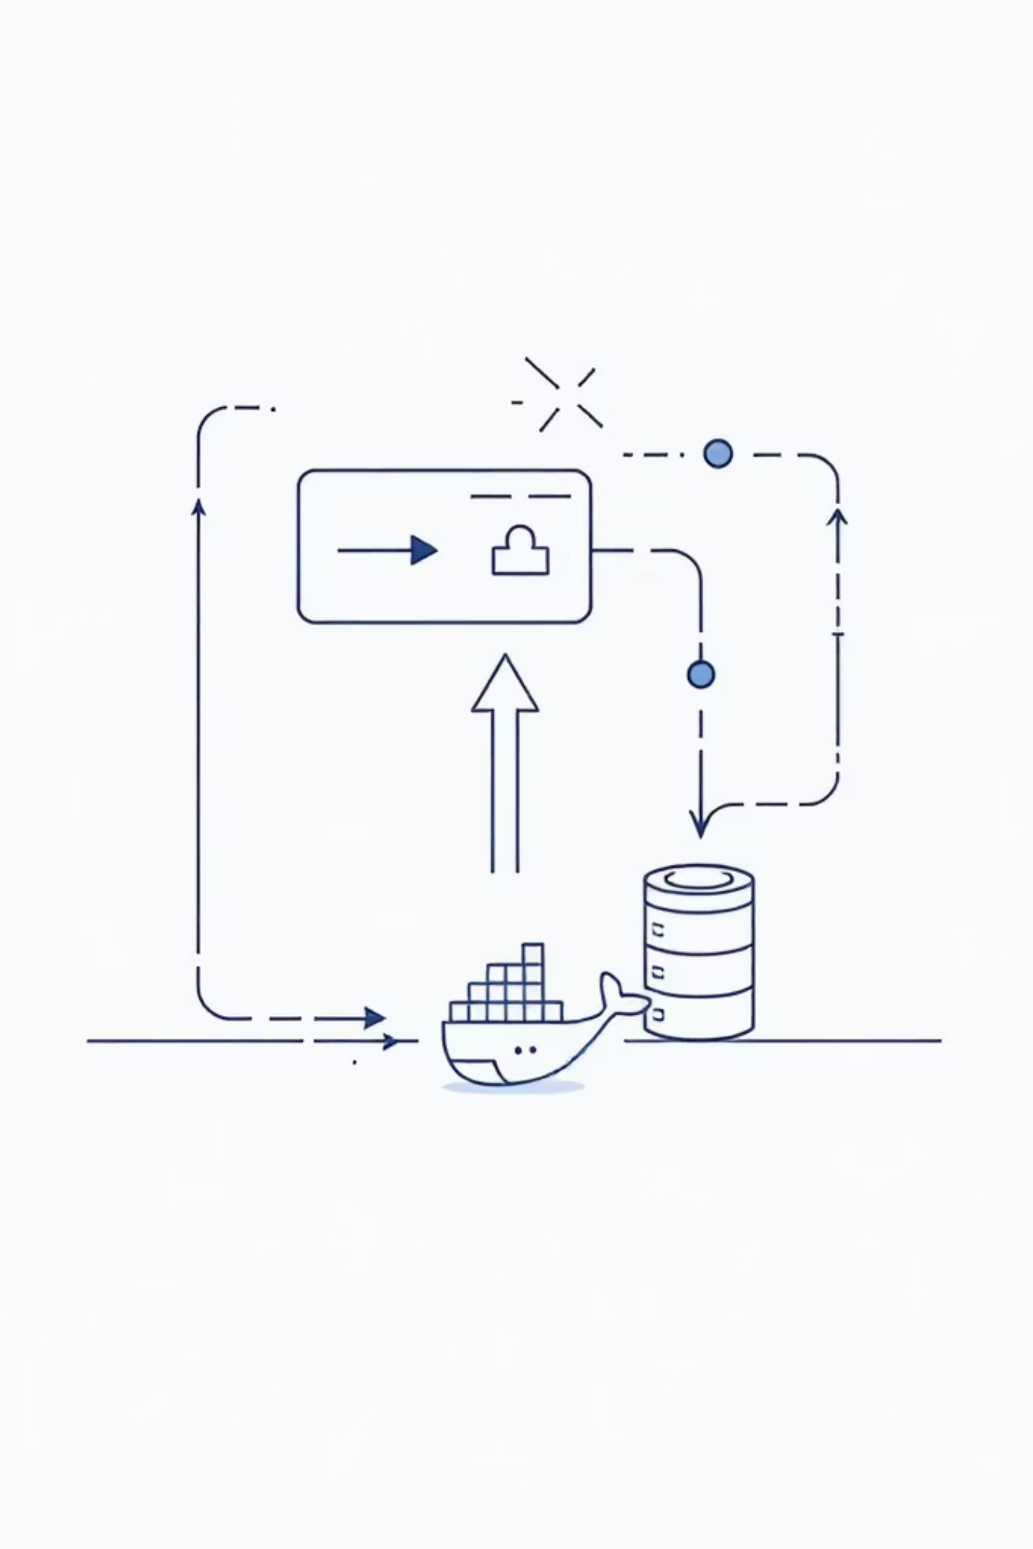
HANDS-ON LAB
Lab 4: Working with Docker Volumes
Ensuring your container data is safe and sound.

Slide 21
ORCHESTRATION
Docker Compose
Docker Compose is a tool for defining and running multi-container Docker applications. It simplifies the process of managing interconnected services (like a web server, a database, and a cache) by using a single YAML configuration file to define the entire application stack, including services, networks, and volumes.
Sample docker-compose.yml
version: "3.9" services: container1: image: nginx:alpine container_name: simple_nginx ports: - "8080:80" container2: image: redis:alpine container_name: simple_redis ports: - "6379:6379"

Slide 22
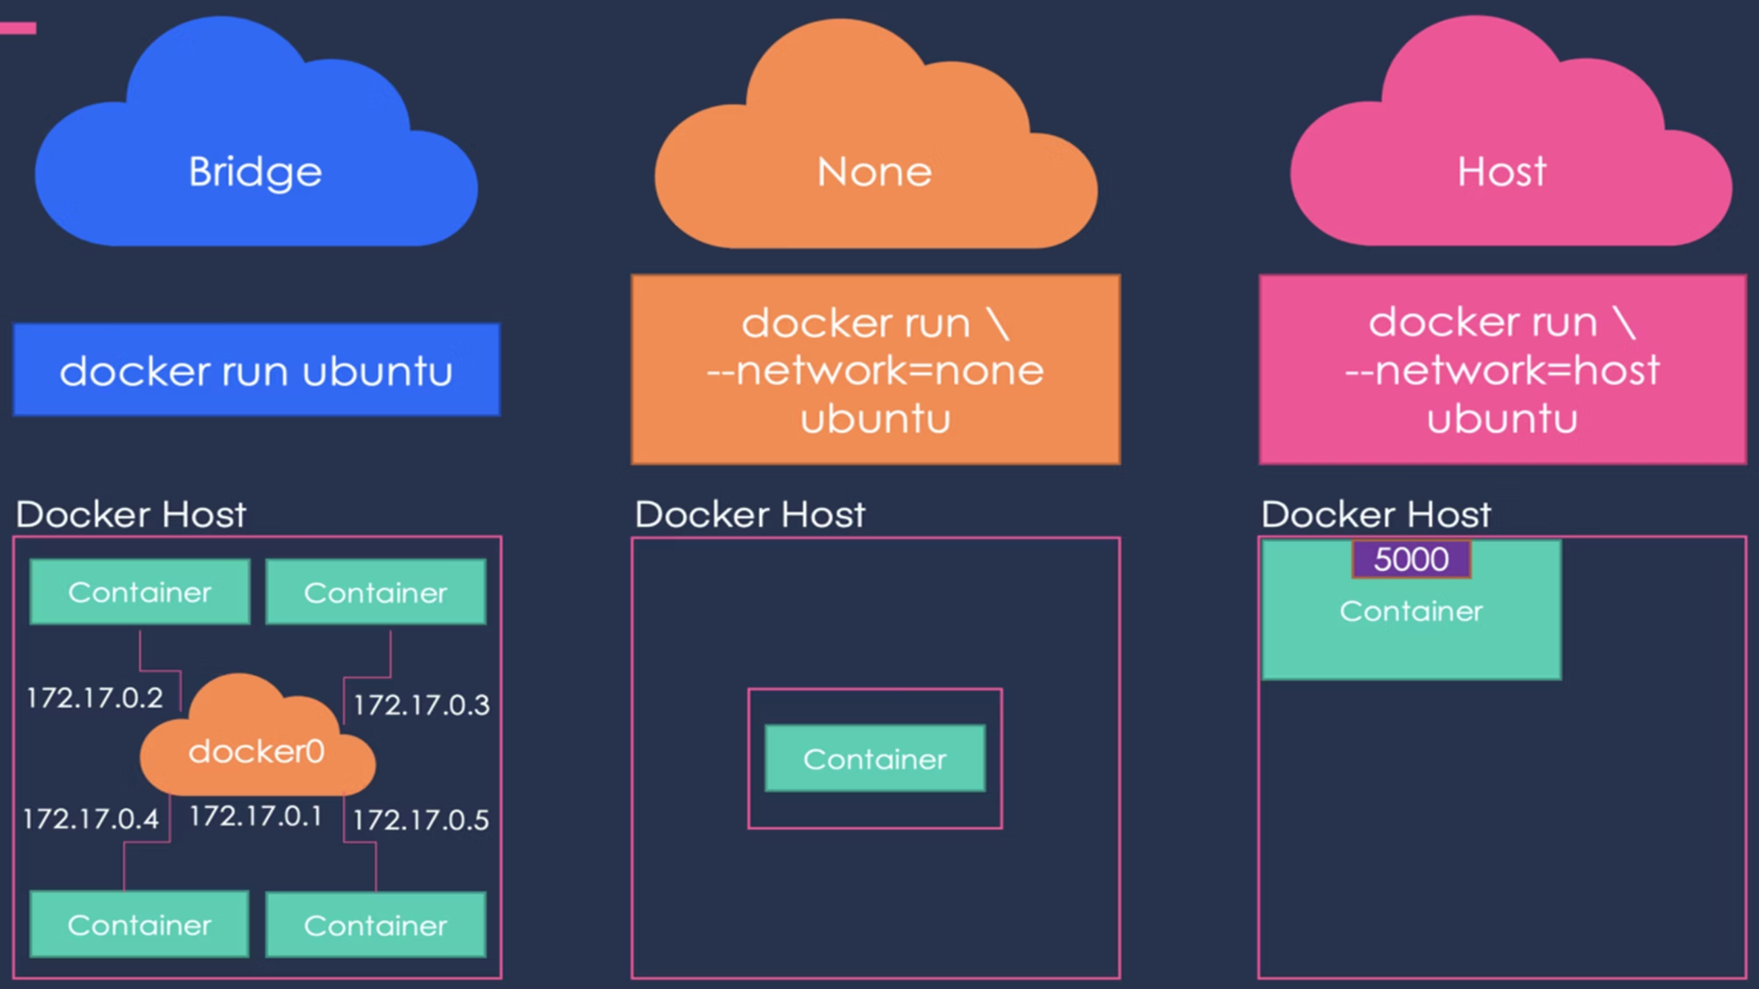
ADVANCED CONCEPTS
Docker Networking

Slide 23
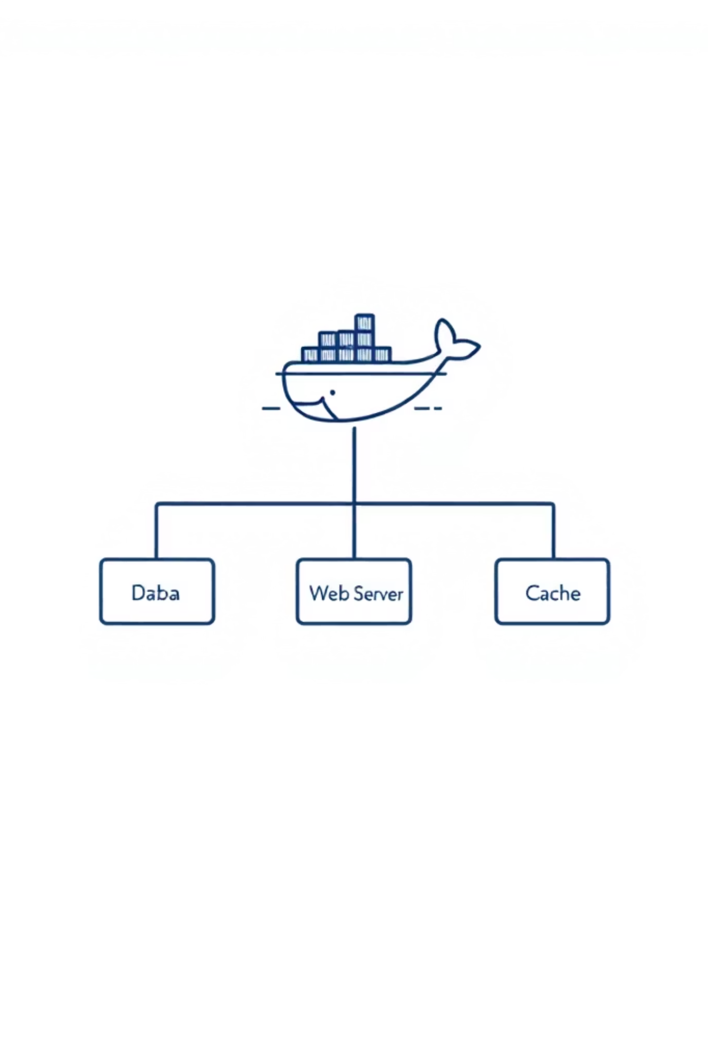
HANDS-ON LAB
Project : Hands-on with Docker Compose
Monitoring Stack with Docker Compose (Prometheus + Grafana + SQL)

Slide 24

CONCLUSION
Summary and Key Takeaways

Slide 25

Thank You!
Any Questions?

